Slide 1

Machine Learning for Engineers: Evaluation Metrics in Classification
Mina Farmanbar
Associate Professor, University of Stavanger
for engineers

Slide 2
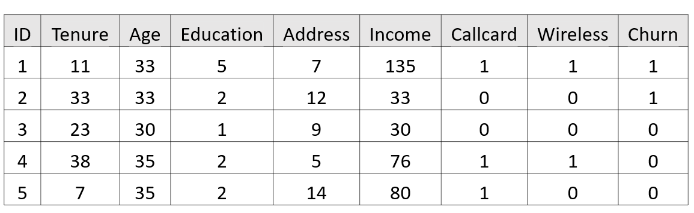


Evaluation Metrics in Classification
Predicted Churn
1
1
0
1
0
Modeling
Classifier
Prediction
Train Set
Test Set
ID | Tenure | Age | Education | Address | Income | Callcard | Wireless | Churn
1 | 11 | 33 | 5 | 7 | 135 | 1 | 1 | 1
2 | 33 | 33 | 2 | 12 | 33 | 0 | 0 | 1
3 | 23 | 30 | 1 | 9 | 30 | 0 | 0 | 0
4 | 38 | 35 | 2 | 5 | 76 | 1 | 1 | 0
5 | 7 | 35 | 2 | 14 | 80 | 1 | 0 | 0
Test
Predicted Labels
Actual Labels

Slide 3
Evaluation Metrics
Evaluation metrics are important for developing a model because they show areas that need improvement.
There are many evaluation metrics, but we will talk about some of them:
Confusion Matrix
F1 score
Area Under the ROC Curve (AUC – ROC)

Slide 4
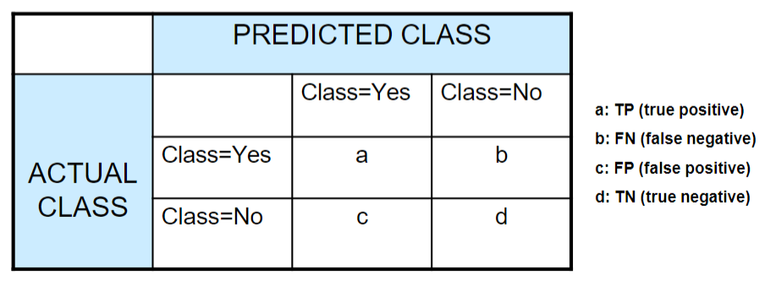
Confusion Matrix
Chapter 3, Tan et.al. Textbook

Slide 5
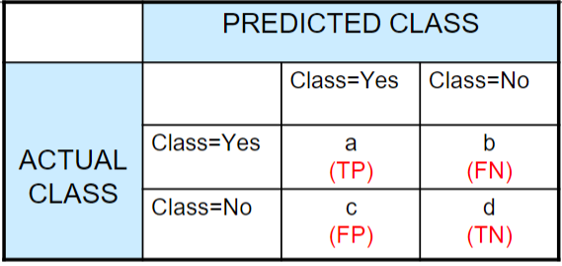
Confusion Matrix
Suppose we had a classification dataset with 1000 data points. We fit a classifier (KNN) on it and get the confusion matrix:
560
50
60
330

Slide 6
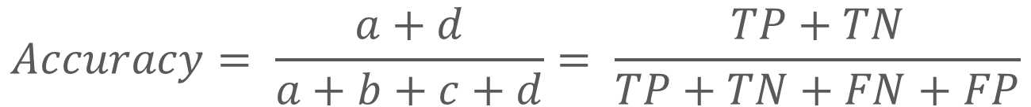
Accuracy
The proportion of the total number of correct predictions that were correct.
Chapter 3, Tan et.al. Textbook
$$Accuracy= \frac{a+d}{a+b+c+d}= \frac{TP+TN}{TP+TN+FN+FP}$$

Slide 7

Confusion Matrix
Our dataset is an example of an imbalanced dataset. There are 947 data points for the negative class and 3 data points for the positive class.
This is how we’ll calculate the accuracy…
Sick
Not Sick
Sick
30
10
Not Sick
30
930
$$Accuracy= \frac{30+930}{30+30+930+10}=0.96$$

Slide 8
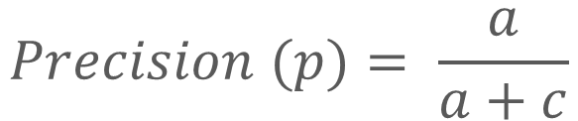
Precision
Chapter 3, Tan et.al. Textbook
Focuses on the correctness of positive predictions.
Asks: “Out of all the emails predicted as spam, what proportion were actually spam?”
$$Precision (p)= \frac{a}{a+c}$$

Slide 9

Recall OR Sensitivity (True Positive Rate)
Chapter 3, Tan et.al. Textbook
Emphasizes capturing all relevant instances.
Asks: “Out of all the actual spam emails, what proportion did the system correctly identify?”
$$Recall (r)= \frac{a}{a+b}$$

Slide 10



Confusion Matrix
Sick people correctly predicted as sick by the model
Sick people incorrectly predicted as not sick by the model
$$Accuracy= \frac{30+930}{30+30+930+10}=0.96$$
Sick
Not Sick
$$Precision \left(p\right)= \frac{30}{30+30}=0.5$$
Sick
30
10
Not Sick
30
930
$$Recall \left(r\right)= \frac{30}{30+10}=0.75$$
Healthy people incorrectly predicted as sick by the model
Healthy people correctly predicted as not sick by the model

Slide 11
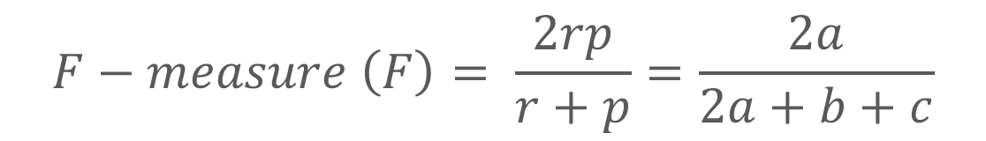
F1 Score
Chapter 3, Tan et.al. Textbook
Is the harmonic mean of precision and recall values for a classification problem. It captures both recall and precision properties
$$F−measure \left(F\right)= \frac{2rp}{r+p}=\frac{2a}{2a+b+c}$$

Slide 12
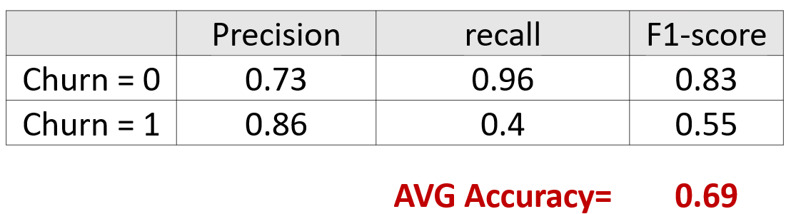
F1 Score
High Accuracy
F1-score: 0.0 … 0.2 … 0.55 … 0.83 … 1.00
F1 score reaches its best value at one, which represents perfect precision and recall, and its worst at zero.
It is a good way to show that a classifier has a good value for both recall and precision.

Slide 13

Specificity (True Negative Rate)
Chapter 3, Tan et.al. Textbook
The proportion of actual negative cases which are correctly identified.
$$Specificity = \frac{d}{c+d}$$

Slide 14
Area Under the ROC Curve (AUC – ROC)
This is one of the popular evaluation metrics used in the industry.
It is like a graph that shows how well a classification model performs.
The curve has two lines:
one for how often the model correctly identifies positive cases (true positives)
another for how often it identifies negative cases as positive by mistake (false positives)

Slide 15
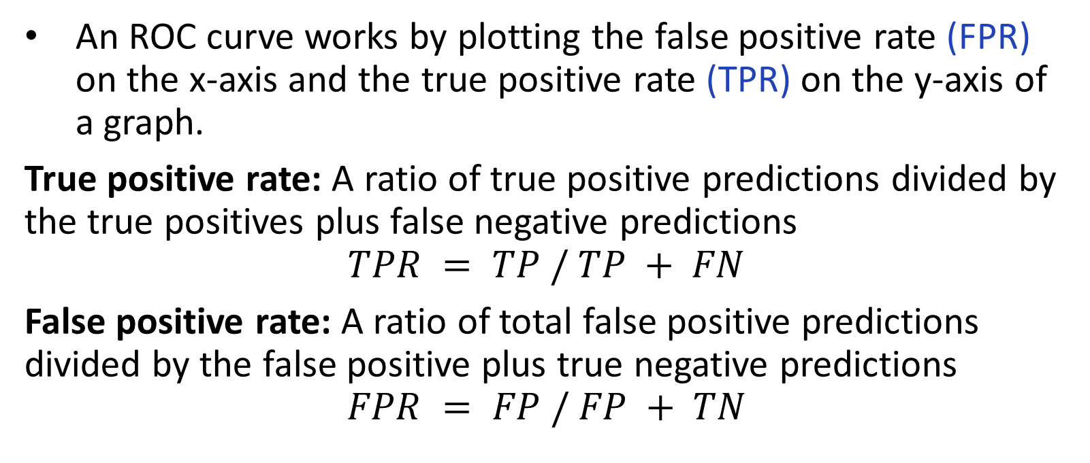
How does a ROC curve work?
An ROC curve works by plotting the false positive rate (FPR) on the x-axis and the true positive rate (TPR) on the y-axis of a graph.
True positive rate: A ratio of true positive predictions divided by the true positives plus false negative predictions
$$TPR = TP / TP + FN$$
False positive rate: A ratio of total false positive predictions divided by the false positive plus true negative predictions
$$FPR = FP / FP + TN$$

Slide 16
Area under the ROC curve
ROC-AUC score is a single number that summarizes the classifier's performance across all possible classification thresholds.
To get the score, you must measure the area under the ROC curve.

Slide 17
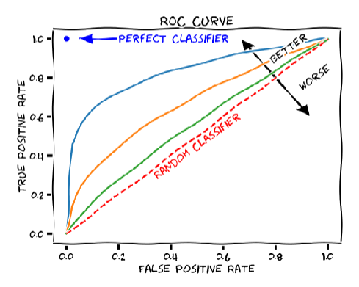
Area under the ROC curve
This score ranges from 0.0 to 1.0, with 1.0 being a perfect classifier.
Chapter 3, Tan et.al. Textbook

Slide 18
Example:
Let us consider the hypothetical data,
True Labels: [1, 0, 1, 0, 1, 1, 0, 0, 1, 0]
Predicted Probabilities: [0.8, 0.3, 0.6, 0.2, 0.7, 0.9, 0.4, 0.1, 0.75, 0.55]

Slide 19
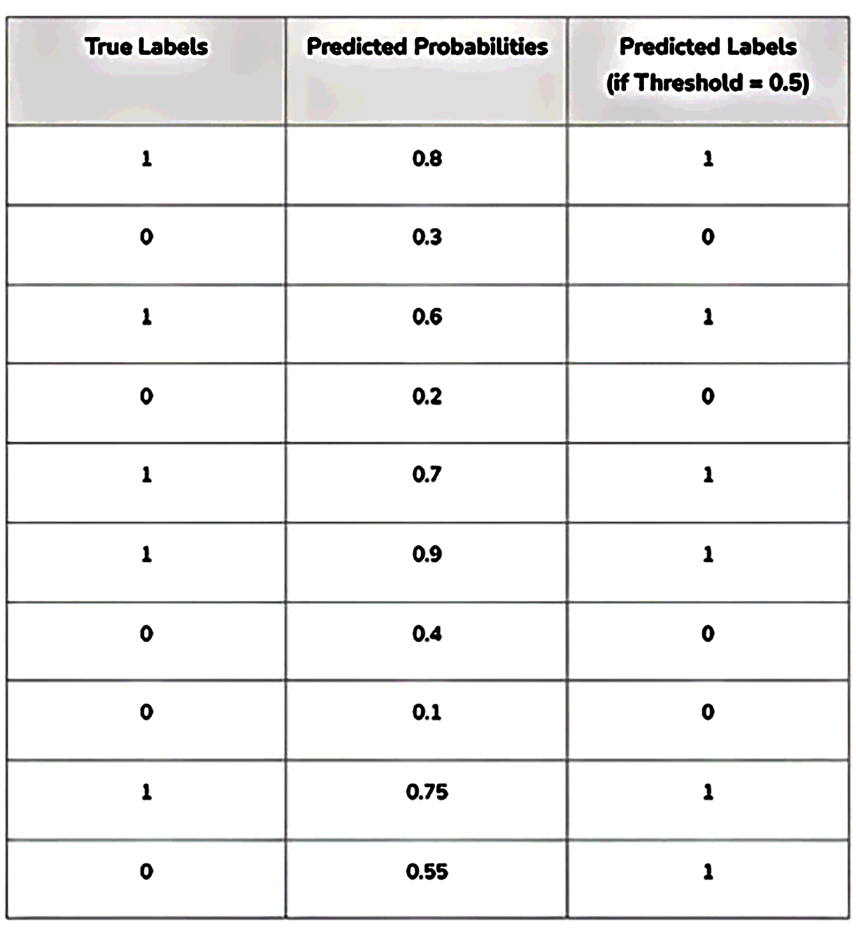
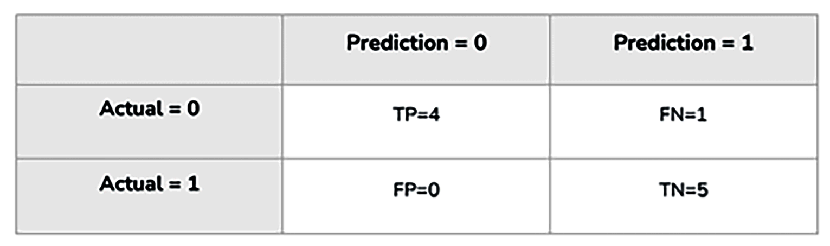
Case 1: Threshold = 0.5
True Positive Rate (Sensitivity): 0.8
False Positive Rate: 0
The interpretation is that the model, at this threshold, correctly identifies 80% of actual positives (TPR) but incorrectly classifies 0% of actual negatives as positives (FPR).

Slide 20
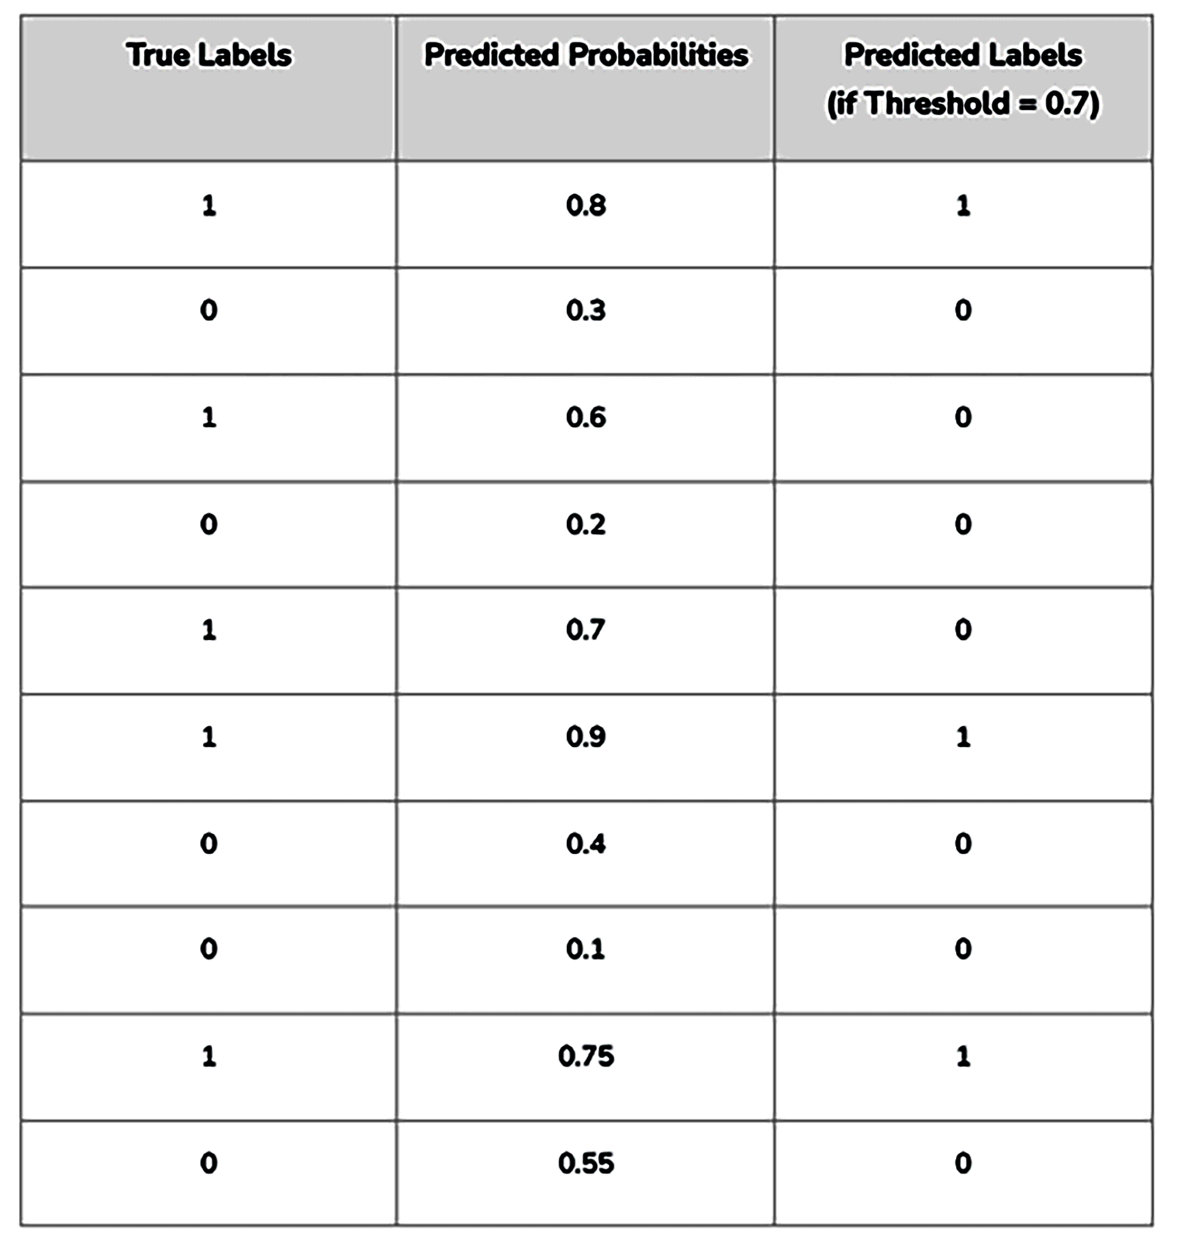
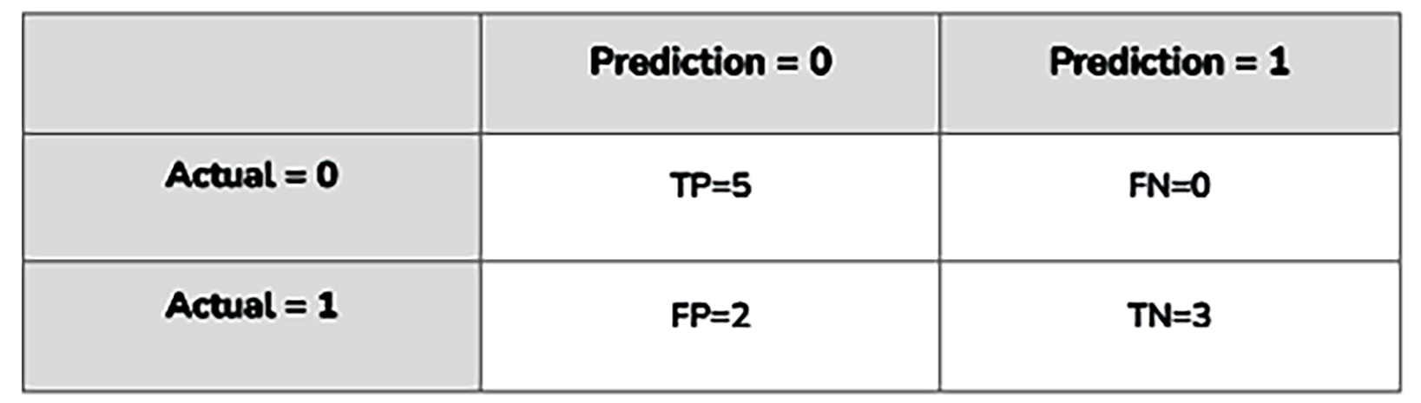
Case 2: Threshold = 0.7
True Positive Rate (Sensitivity): 1.0
False Positive Rate: 0.2

Slide 21
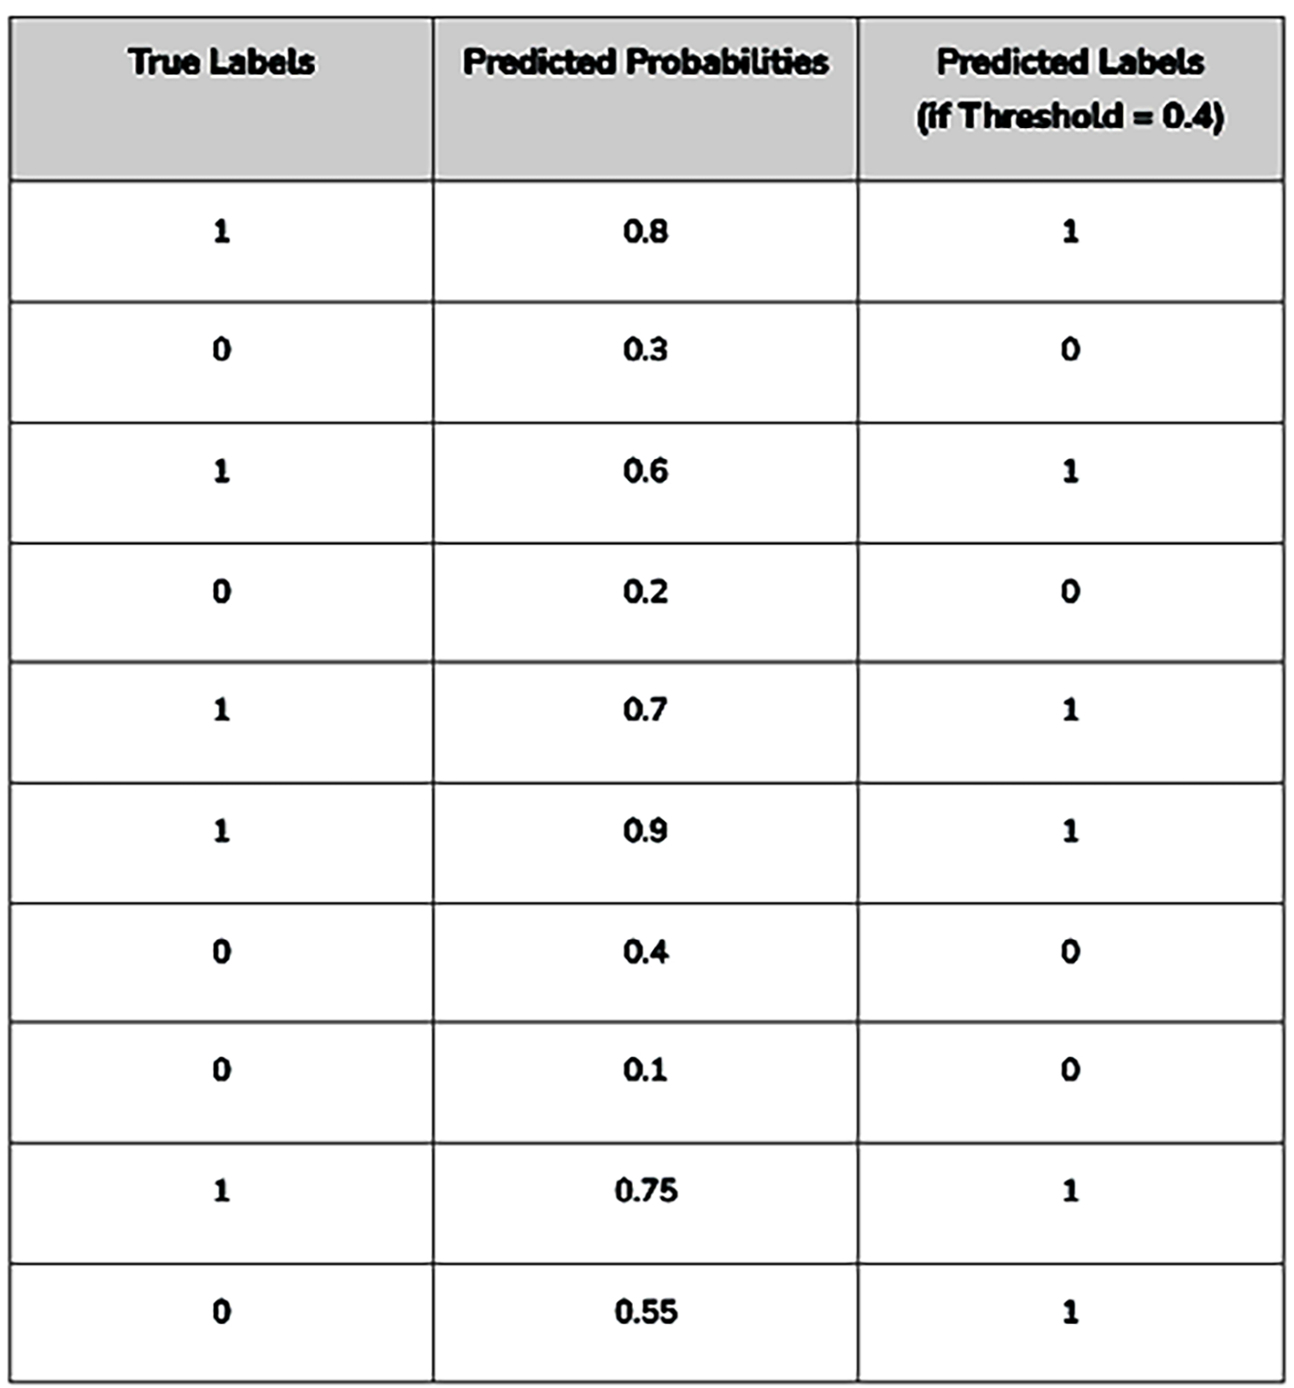
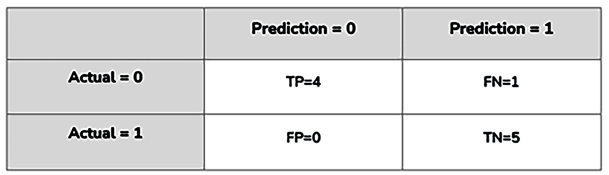
Case 3: Threshold = 0.4
True Positive Rate (Sensitivity): 0.8
False Positive Rate: 0

Slide 22
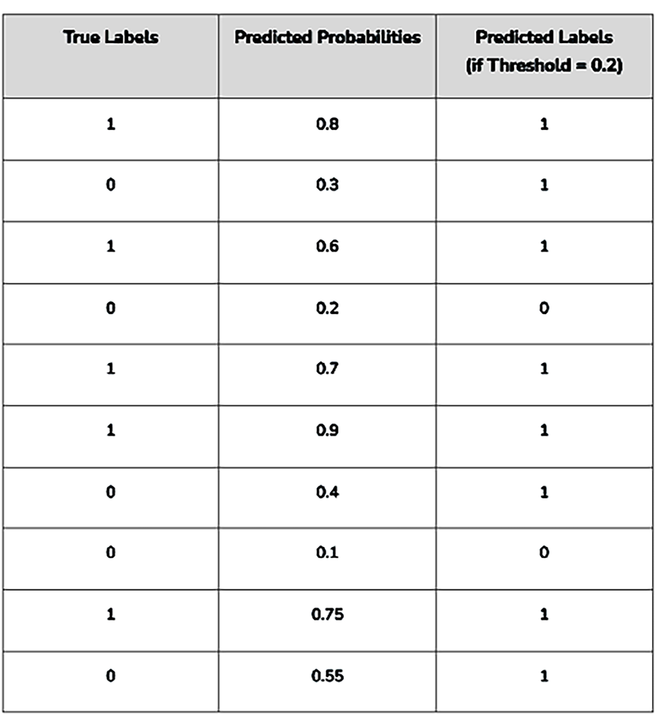
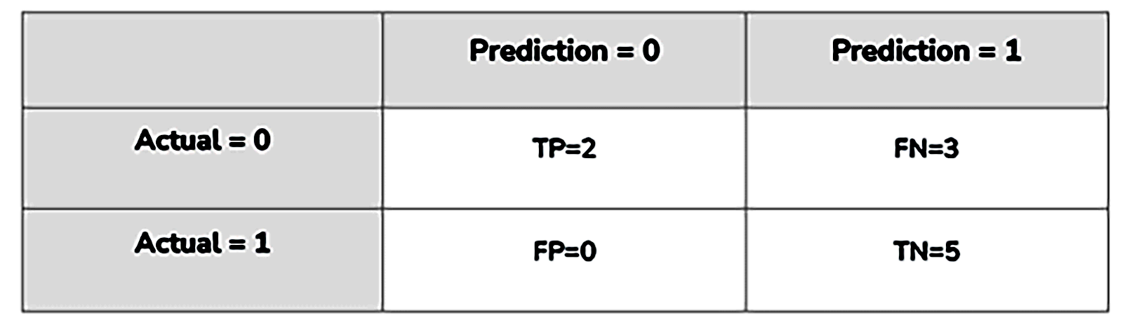
Case 4: Threshold = 0.2
True Positive Rate (Sensitivity): 0.4
False Positive Rate: 0

Slide 23
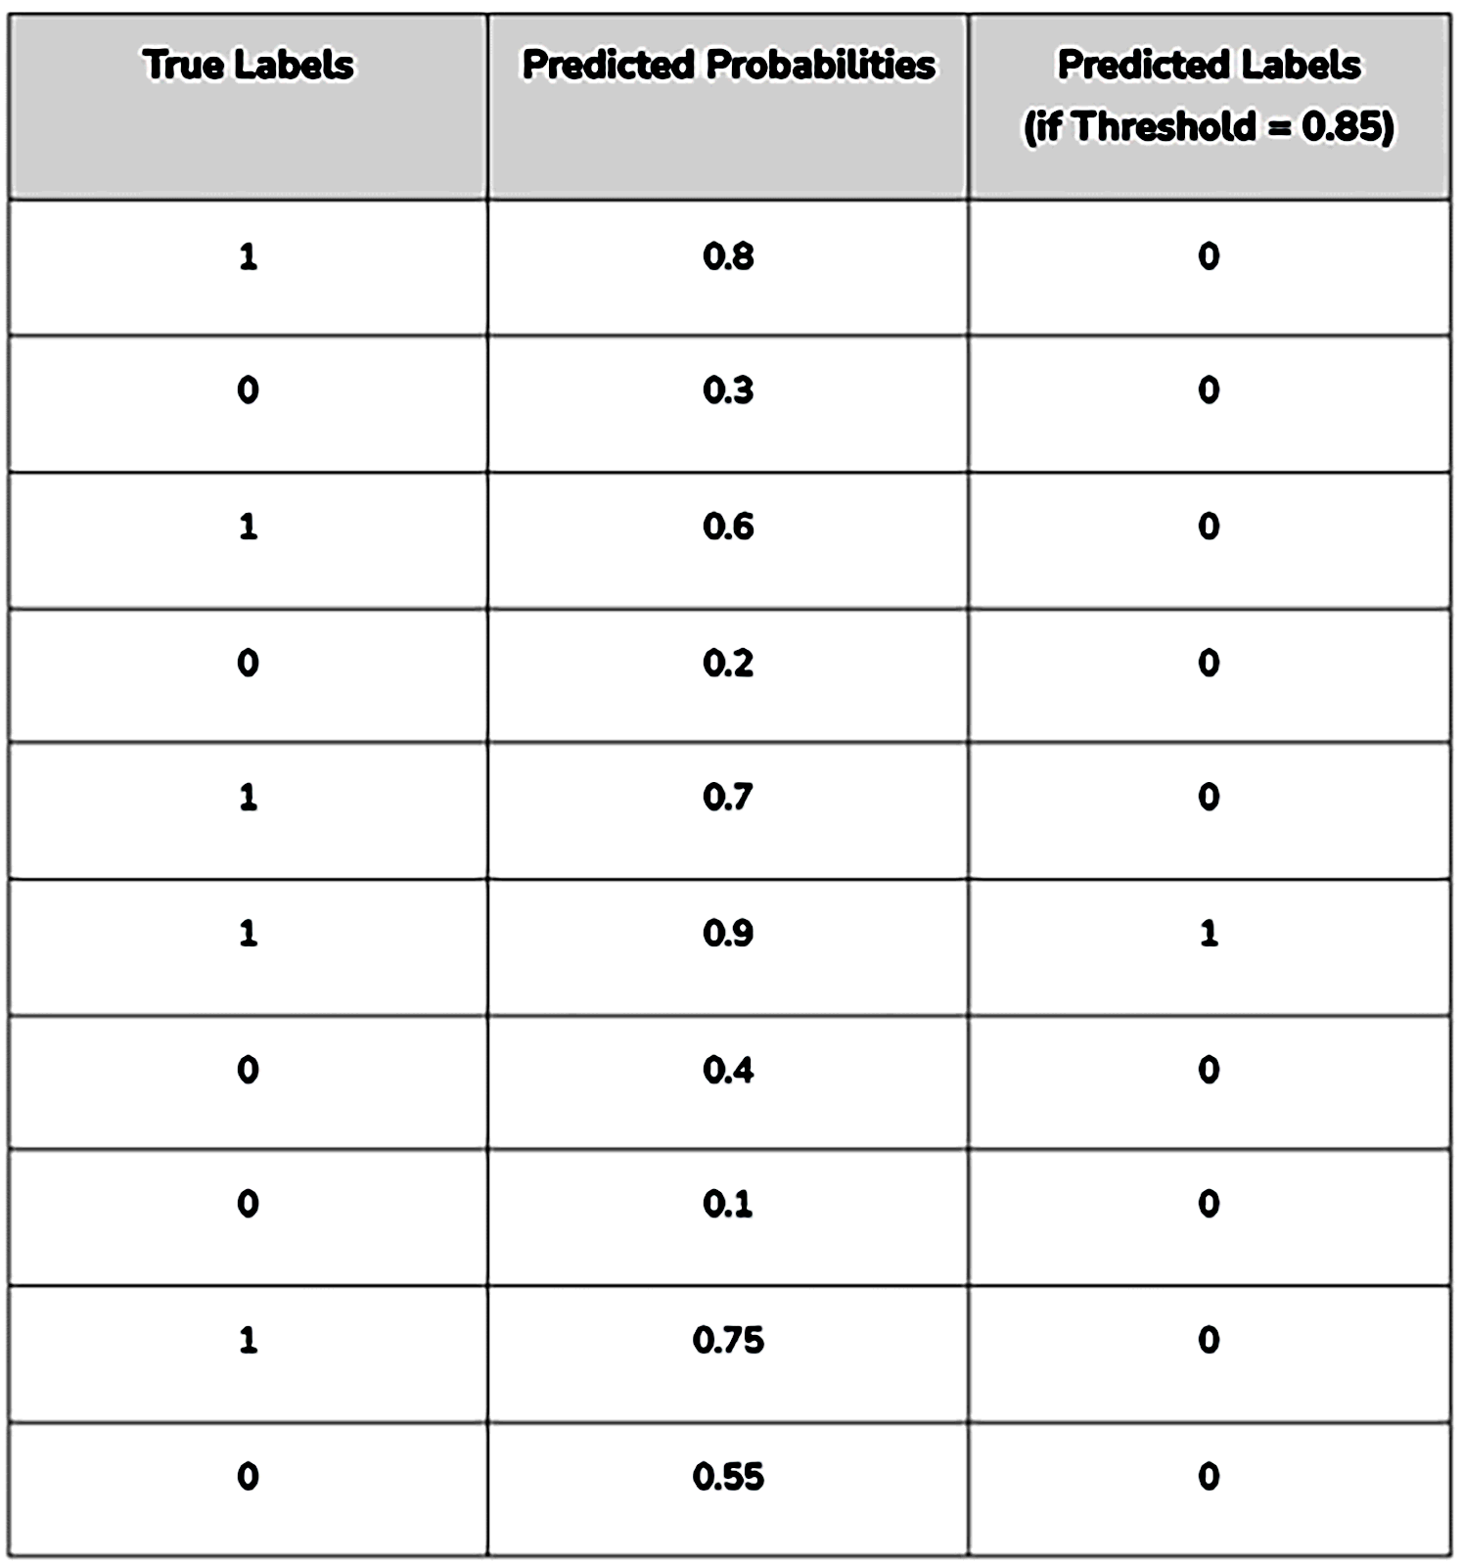
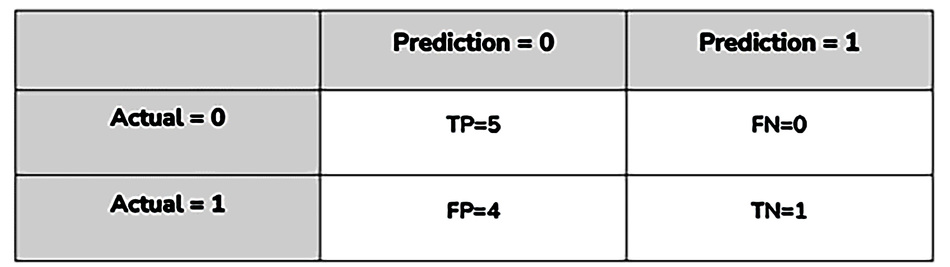
Case 5: Threshold = 0.85
True Positive Rate (Sensitivity): 1.0
False Positive Rate: 0.8

Slide 24
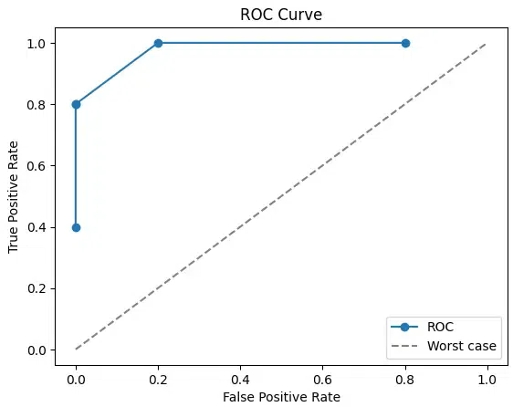
ROC
Threshold = 0.7
Threshold = 0.85
Threshold = 0.4 and 0.5
Threshold = 0.2
https://bit.ly/4chErUt
The best possible AUC value is 1.0, corresponding to a model that achieves 100% sensitivity (true positive rate) and 100% specificity (1 - false positive rate).

Slide 25
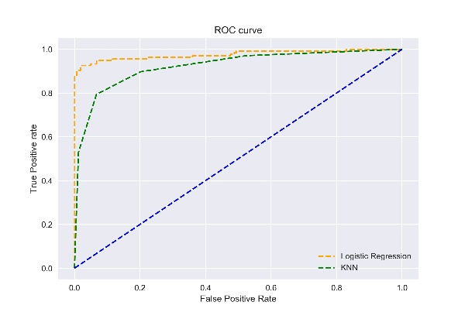
ROC
https://av-eks-blogoptimized.s3.amazonaws.com/ROC40873.jpg

Slide 26
Summary
In general, when evaluating models or systems, we often focus on specific metrics that reflect the goals of our analysis.
Metrics like sensitivity, specificity, accuracy, precision, and recall and F1-score are used to measure the performance of models.

Slide 27
Thank you
Mina Farmanbar
mina.farmanbar@uis.no

